Slide 1


(STATE NAME) & Microsoft Power Platform Roundtable
Insert State Flag here
Notes:
Thanks
Roundtable: Series of events that Microsoft is hosting to bring together agencies in New Mexico into one place to discuss how we are using low-code technology to address needs n business scenarios.
5 series event, one each month. Each will be a different topic.
Not a one way street, but also sharing together. We talk to a lot of agencies that deal with similar problems, an opportunity to break silos and share ideas across agencies.
Designed for two user groups: those who have interest, those who are experienced.

Slide 2
Schedule
Session | Topic | Demo
1 | Digitizing Paper Processes in the Cloud | Onboarding Checklists, Capturing Signatures on Forms
2 | Using Machine Learning to Accelerate Mobile Inspections in the Field | Mobile app for collecting data, using AI to detect type of fish
3 | Supporting Collaboration in a remote setting | Integrating Power Apps into Microsoft Teams, Approval flows
4 | Integrating Power Apps/Automate with 3rd party services | Standard Connectors, Premium Connectors, and Custom Connectors
5 | Automate (almost) Anything on your Computer with Robotic Process Automate (RPA) | Inputting data into a legacy application from the cloud
6 | Building a chatbot with Power Virtual Agents (PVA) | Well Permitting Application Assistant

Slide 3
Agenda
Recap
Solution Demo
Solution Build
Q&A
Q&A / Ideation
Notes:
Conversation: for me the technology is boring. It’s the medium to achieve something. Solutions, problem being solved.

Slide 4





Power Apps
Application development
Power Automate
Process automation
Power Virtual Agent
The Power Platform
Power BI
Business analytics

Slide 5
Stages
Stage 1
App Building
Common Data Service
Pen Input
Stage 2
Mobile apps
AI Model Training
Security
Stage 3
Office suite integration
Built in connectors
Power Automate
Stage 4
Enriching Power Platform with “Pro code” resources
Stage 5
Robotic Process Automation
Adv. Power Automate
Notes:
Time
Topic
Demo
October 2020
Digitizing Paper Processes in the Cloud
Onboarding Checklists, Capturing Signatures on Forms
November 2020
Supporting Collaboration in a remote setting
Integrating Power Apps into Microsoft Teams, Approval flows
December 2020
Using Machine Learning to Accelerate Mobile Inspections in the Field
Mobile app for collecting data, using AI to detect type of fish
January 2021
Integrating Power Apps/Automate with 3rd party services
Standard Connectors, Premium Connectors, and Custom Connectors
February 2021
Automate (almost) Anything on your Computer with Robotic Process Automate (RPA)
Extracting data from a legacy application

Slide 6
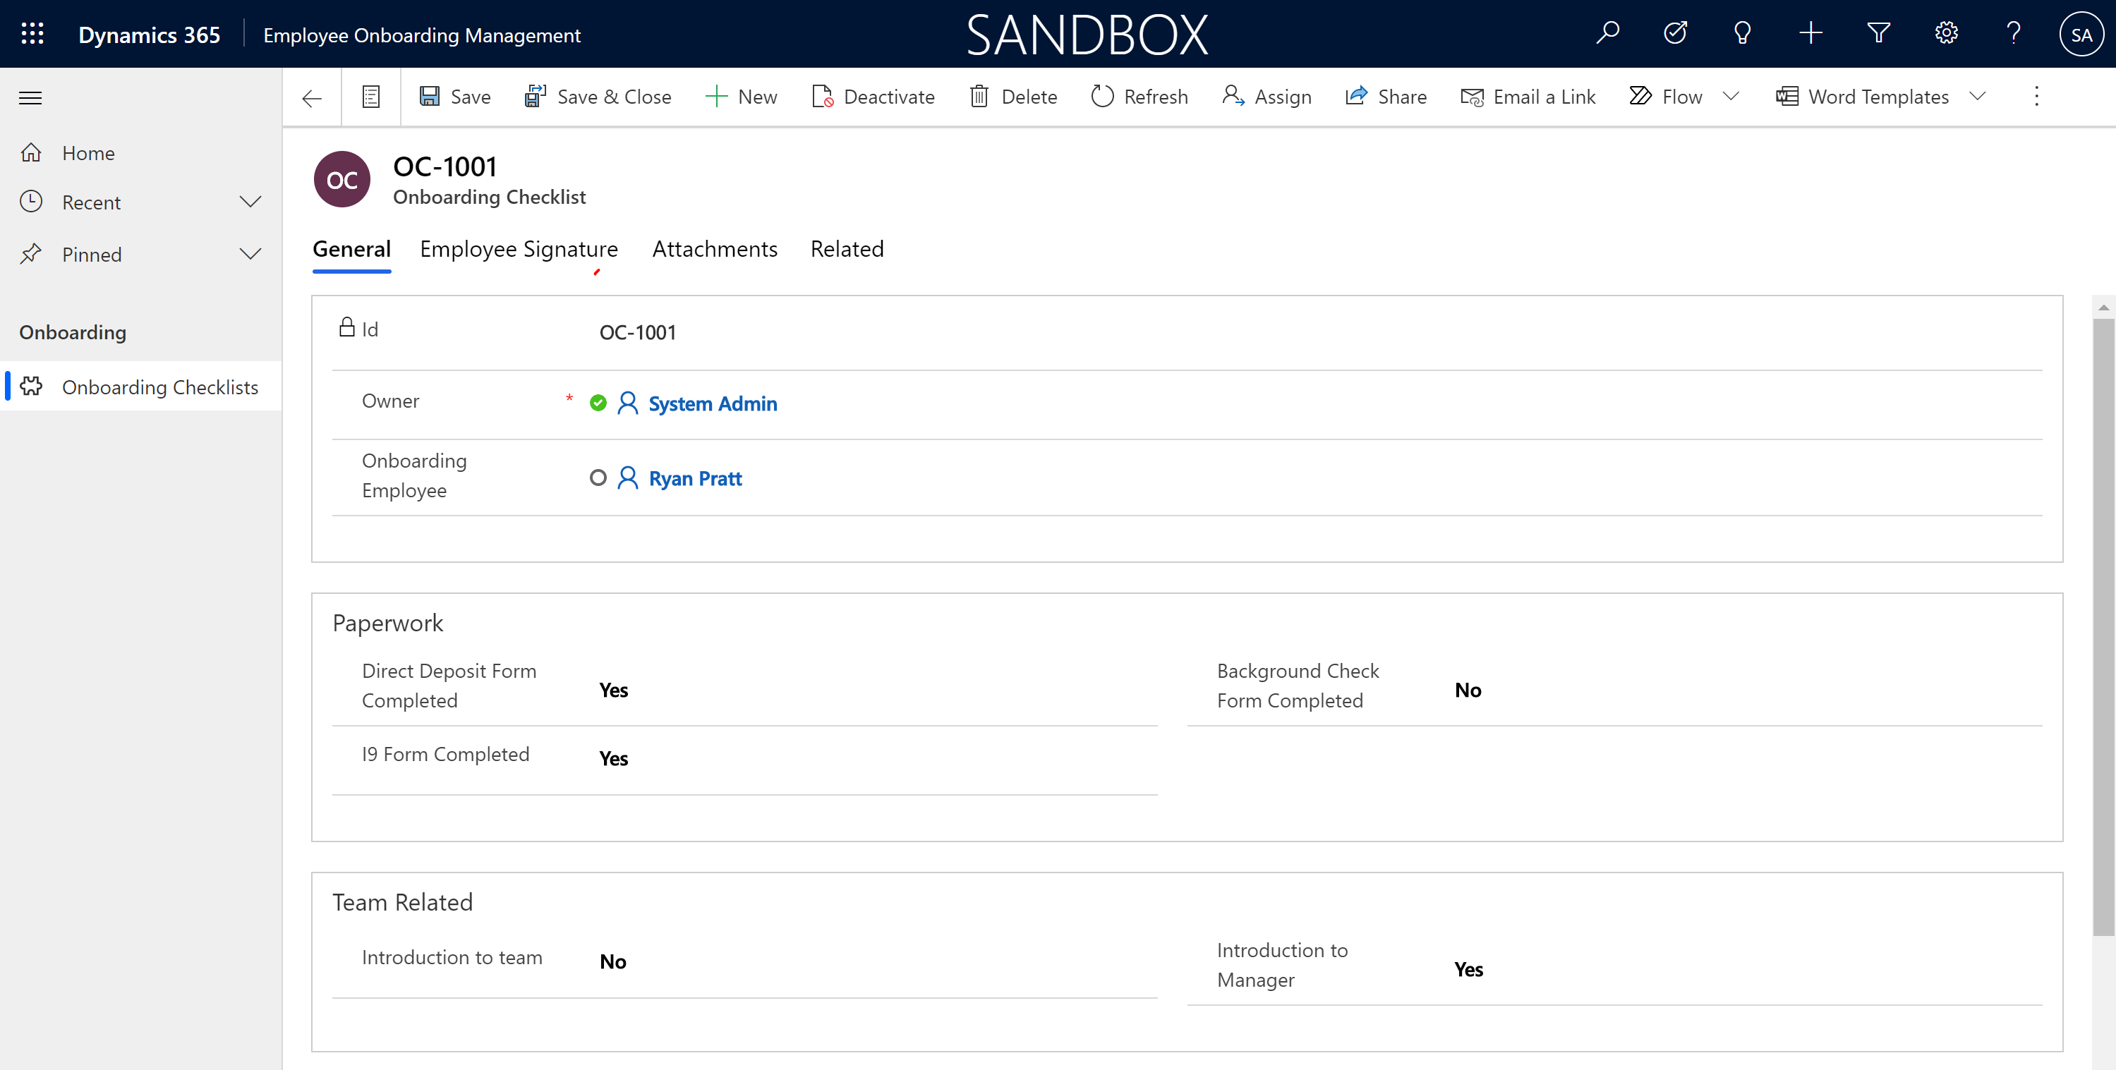
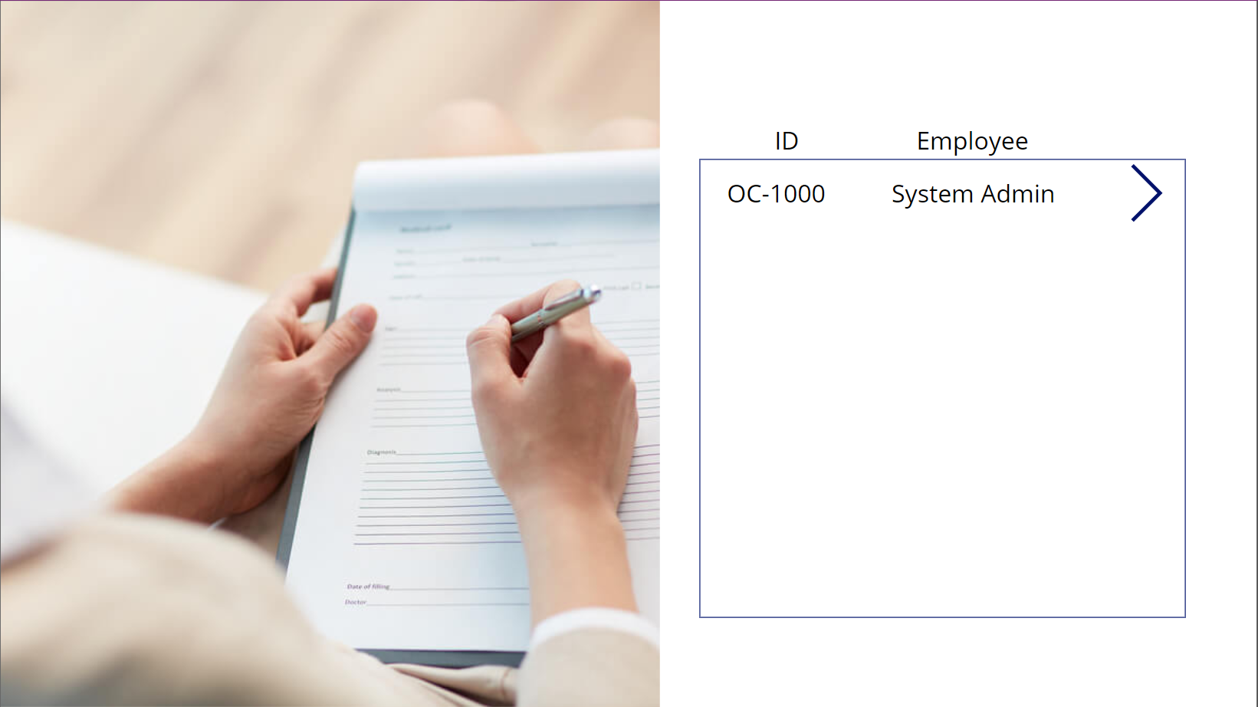
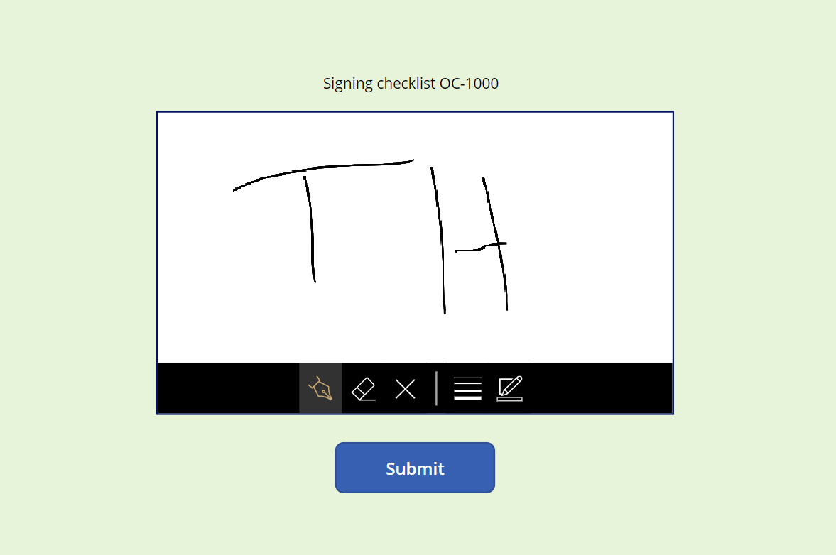

Slide 7
Onboarding Checklist
Paperwork
Direct Deposit Form
Background Check Form
I9 Form
Team Related
Introduction to manager
Introduction to team
Training
Harassment Prevention Training
Role specific training
Equipment
Laptop supplied
Badge supplied
Expense card issued
Notes:
Onboarding Employee (user)
Paperwork = Mark it & Attach files.
Signature from employee to confirm employment

Slide 8
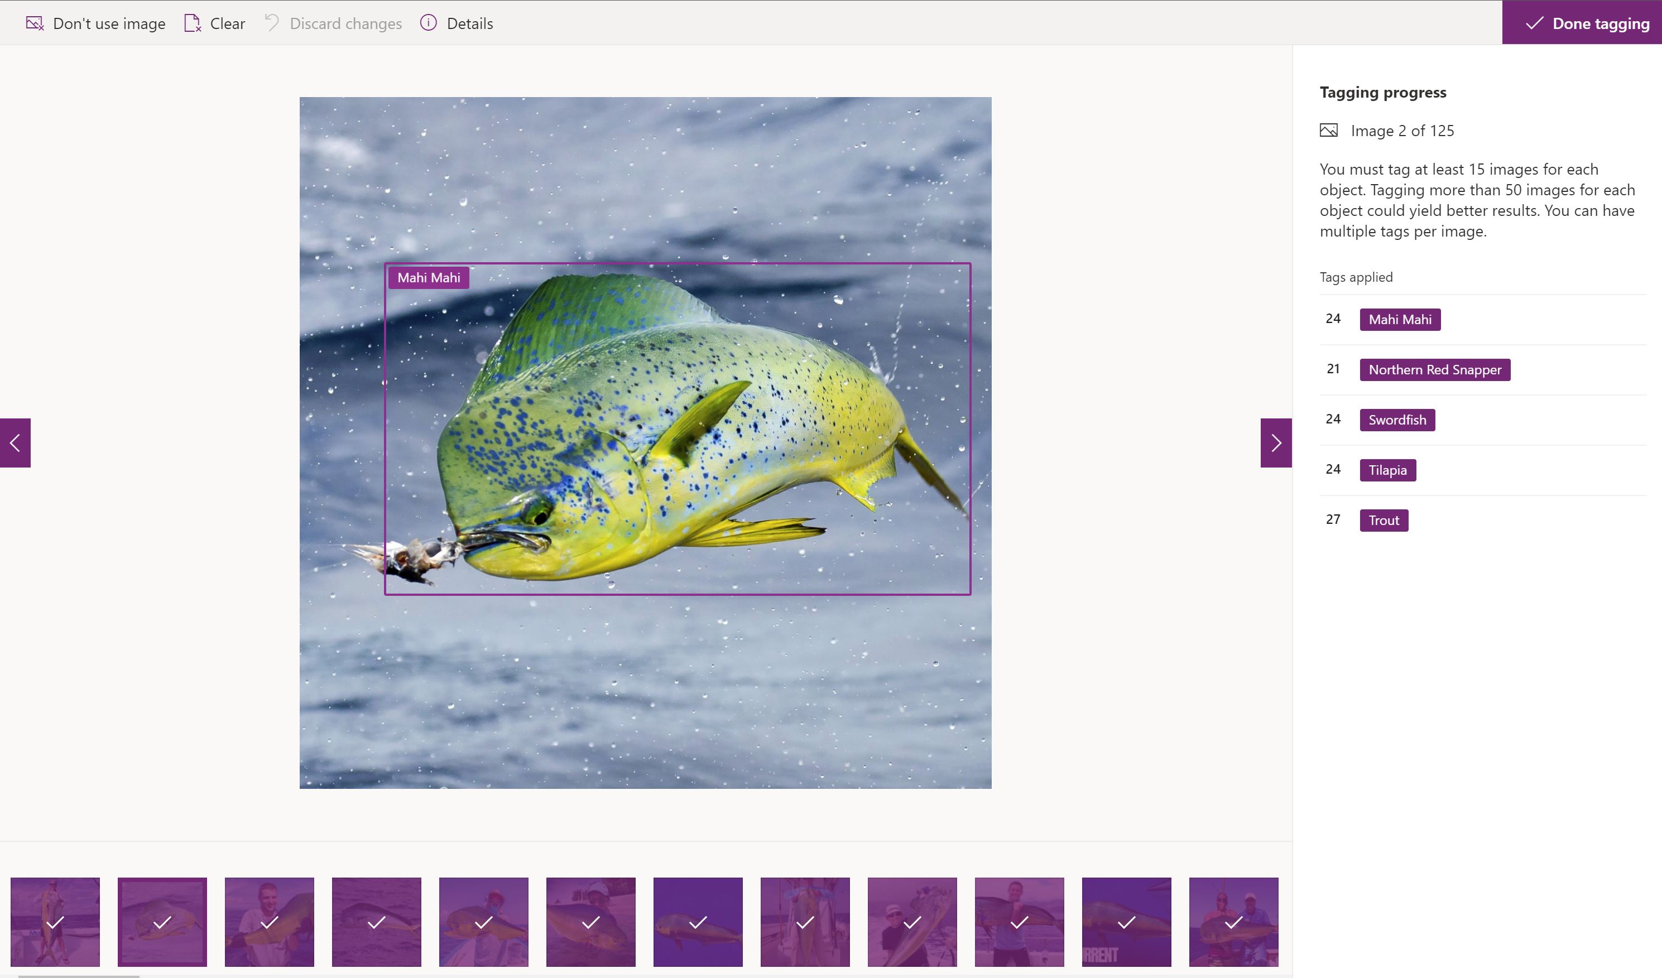
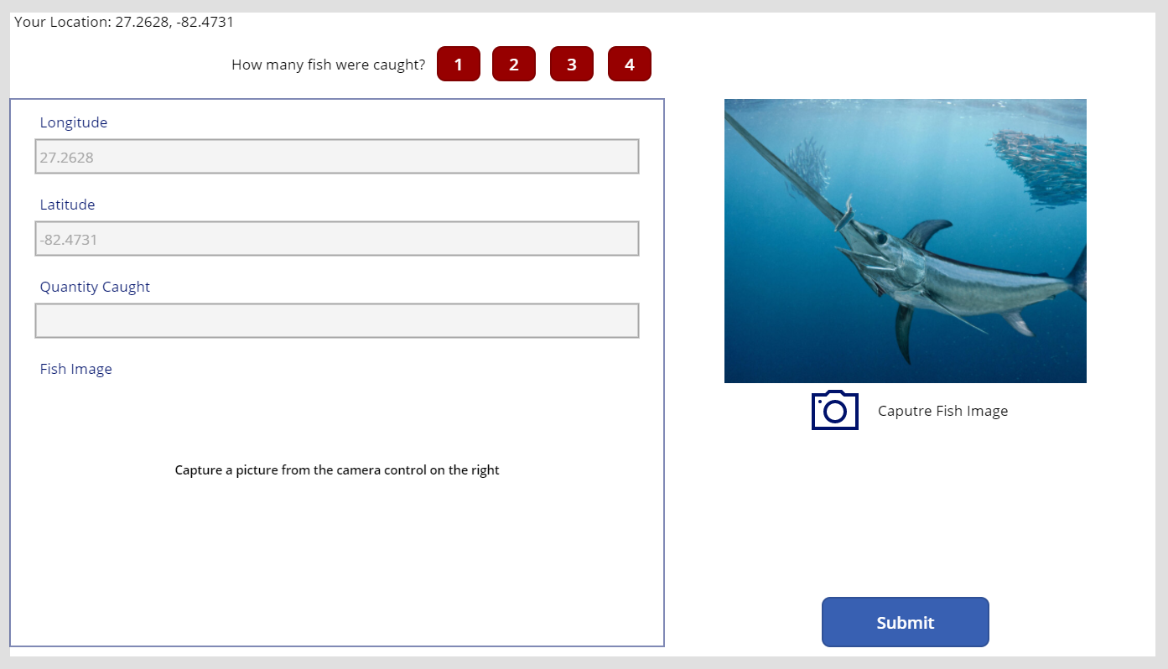
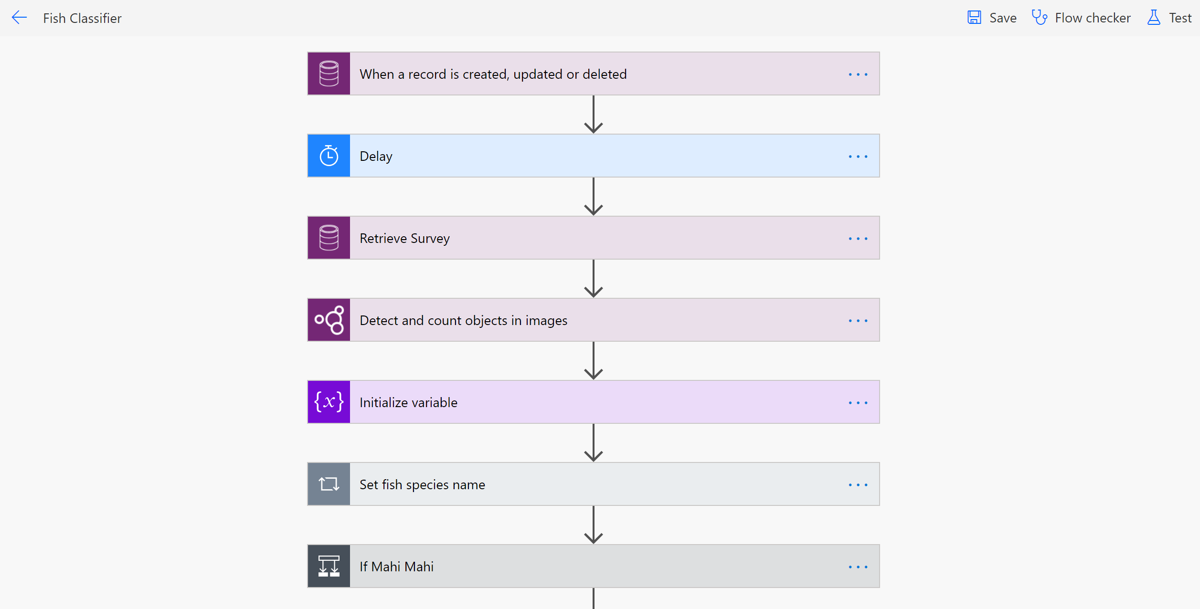
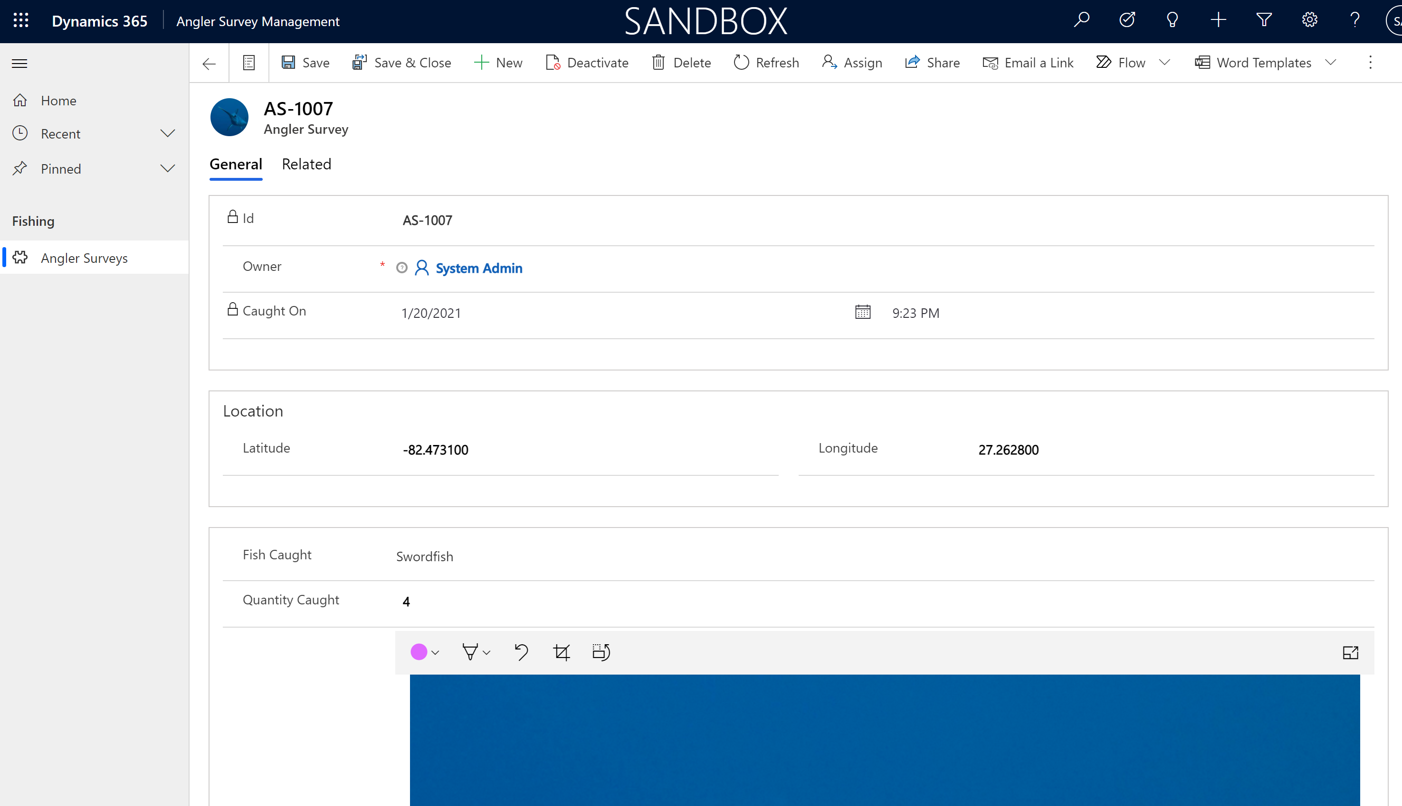

Slide 9
Fish Species Detection
Train AI Model
Create fish classification cloud flow
Create mobile application
Create “back-end” application
Notes:
Onboarding Employee (user)
Paperwork = Mark it & Attach files.
Signature from employee to confirm employment

Slide 10
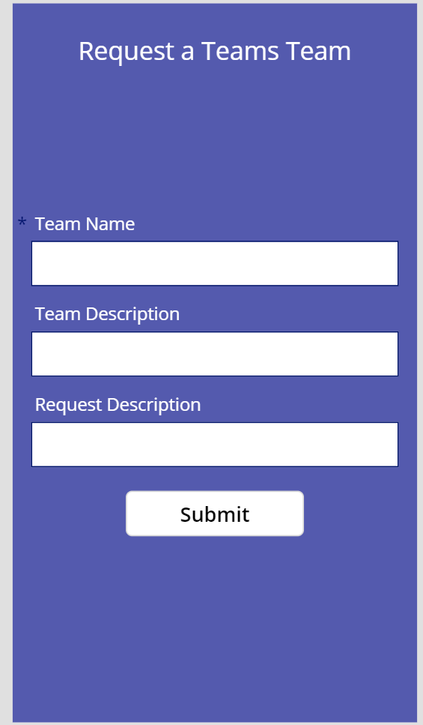
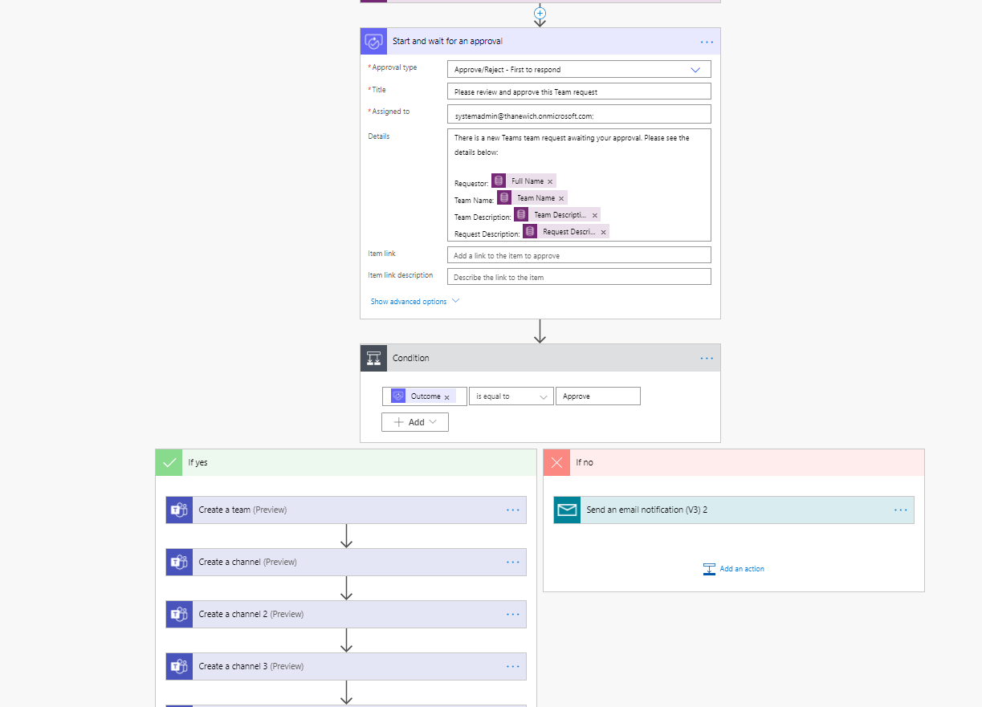
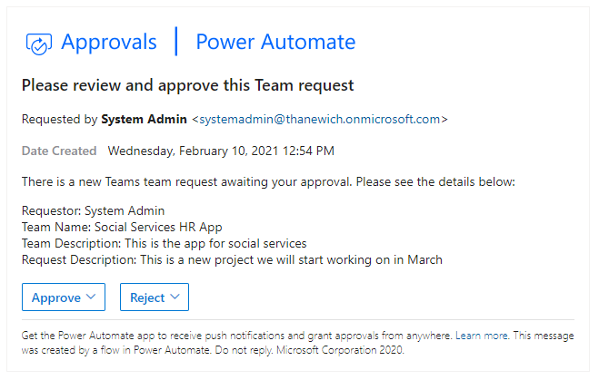
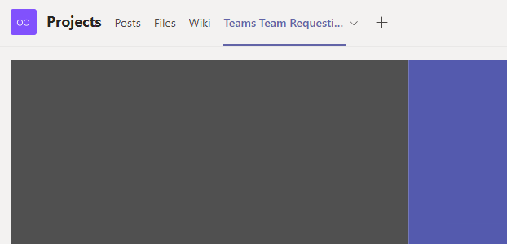
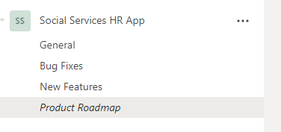

Slide 11
Teams Team Requesting
Data Model
Requesting App
Approval & Creation Flow
Embed App in Teams
Notes:
Onboarding Employee (user)
Paperwork = Mark it & Attach files.
Signature from employee to confirm employment

Slide 12
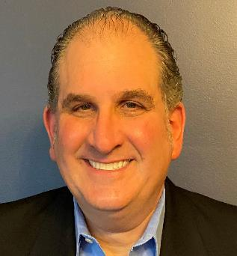
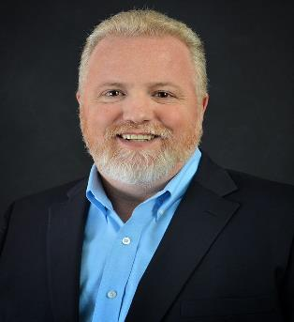
Catapult
Spencer
Stern
Tim
Cone
Dynamics
Practice Director
Productivity Practice Director
spencer.stern@catapultsystems.com
timothy.cone@catapultsystems.com
Notes:
v

Slide 13
Request Team on App
New “Team Request” Record Made in Dataverse
Power Automate Flow picks up the request, starts an approval & waits
Person accepts the request in email
The Power Automate flow
Creates the Team
Adds the Channels
Assigns the owner

Slide 14
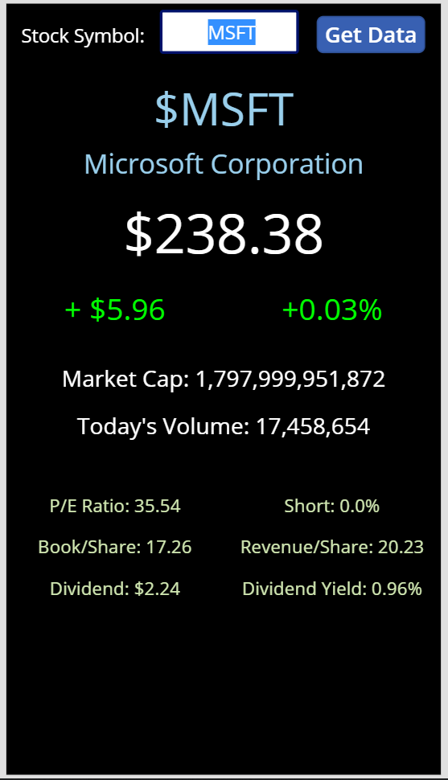
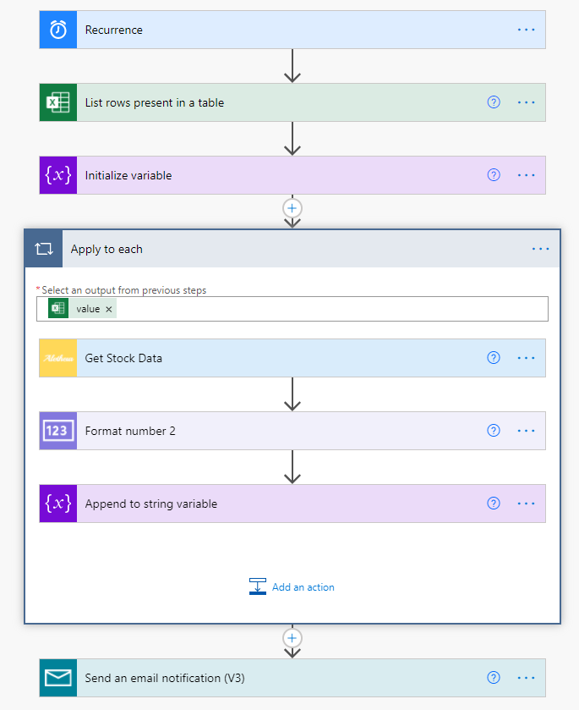
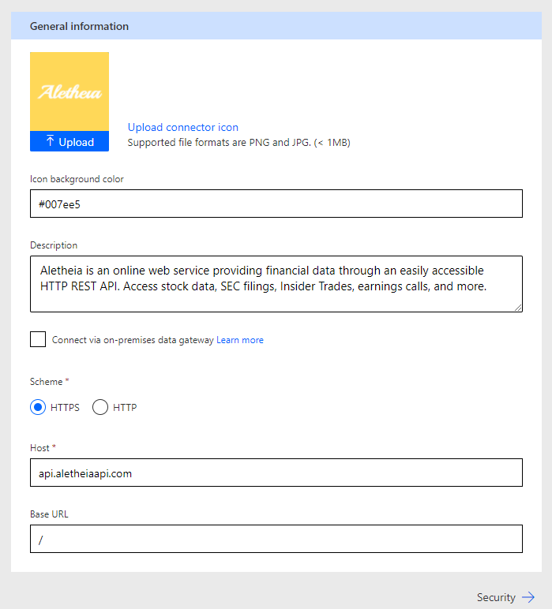
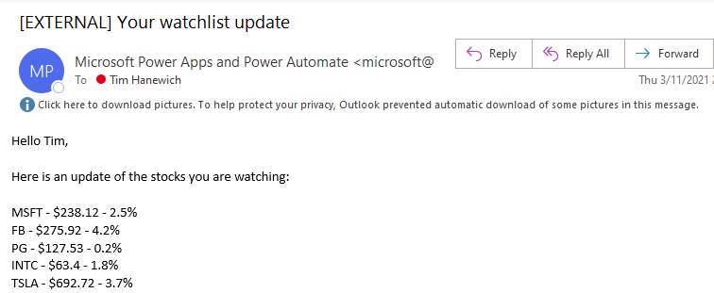
https://aletheiaapi.com

Slide 15
Can the Power Platform “talk” to ______ system?
Do we have an OOTB connector?
https://flow.microsoft.com/en-us/connectors/
Is _______ system web-enabled?
Can we use robotic process automation to automate?

Slide 16
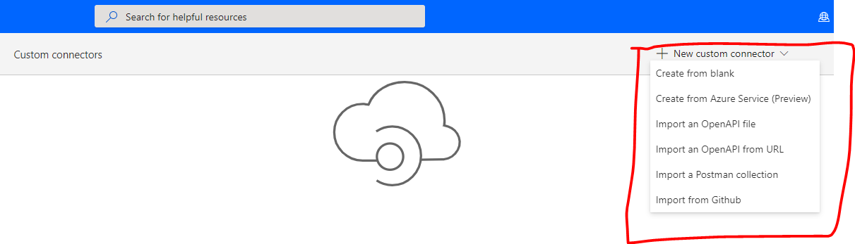
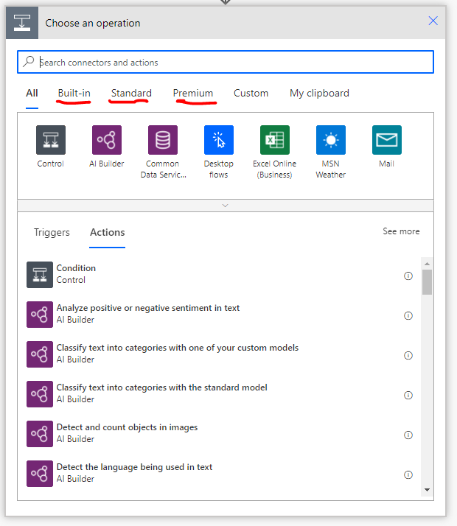
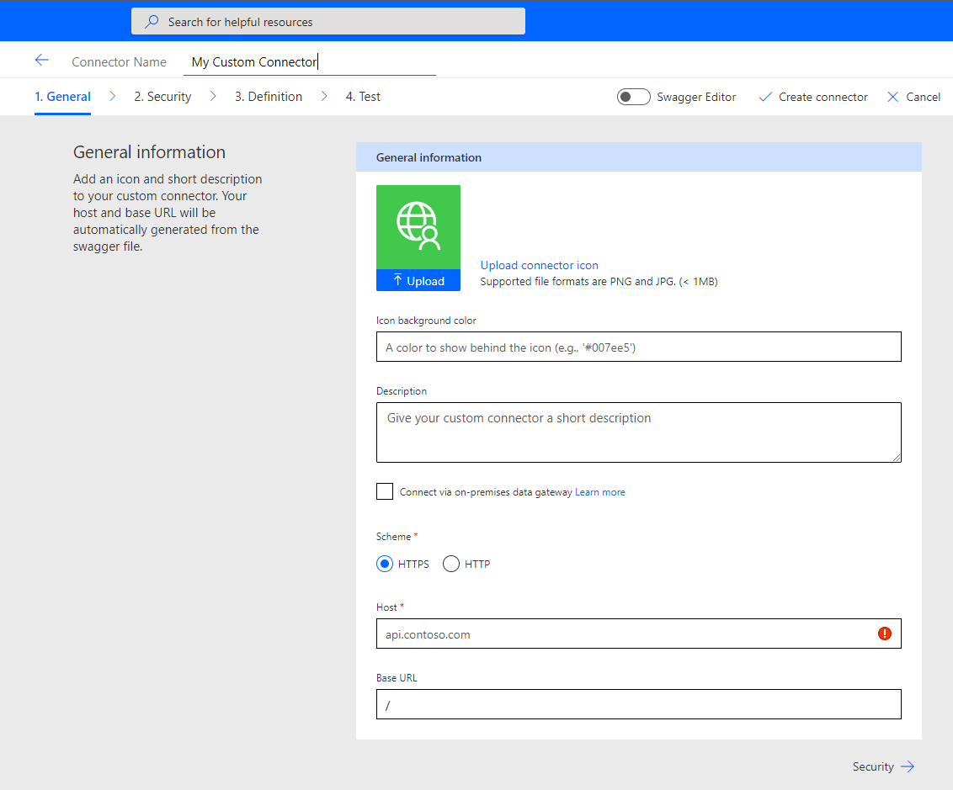
Connector
Custom Connector
List of supported connectors | Microsoft Power Automate

Slide 17
Custom API Integration
Create the Custom Connector
Leverage our connector in Power Apps – Stock Quote App
Leverage our connector in Power Automate – Automated EOD watchlist update
Notes:
Onboarding Employee (user)
Paperwork = Mark it & Attach files.
Signature from employee to confirm employment

Slide 18
Components of an HTTP Request
POST
https://api.CoolApiService.com/addNumbers?method=sum
Key: LISJ2
Username: Will_Robinson
{“numbers”:[25, 70,30]}

Slide 19


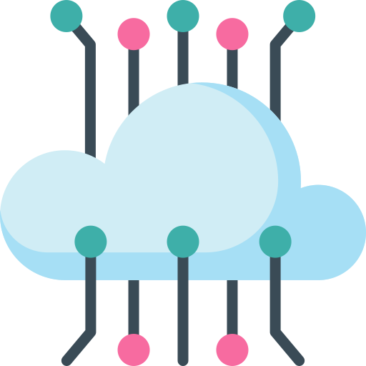

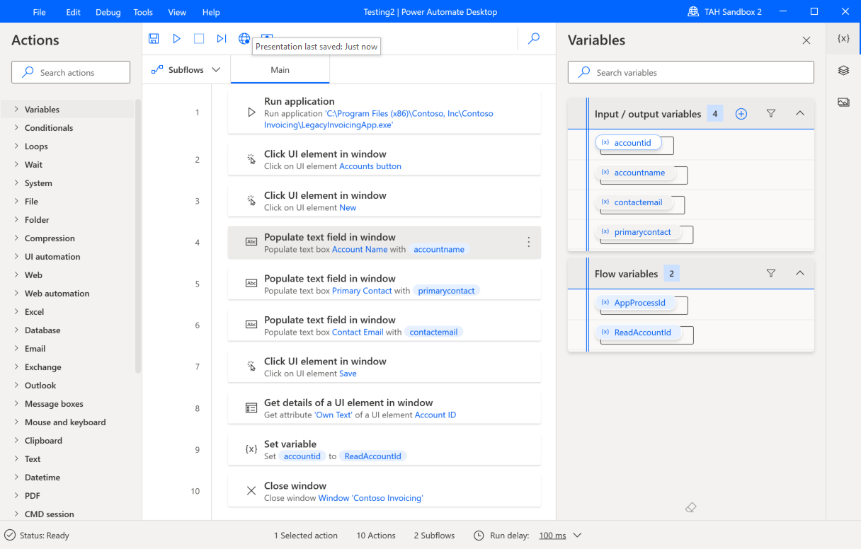
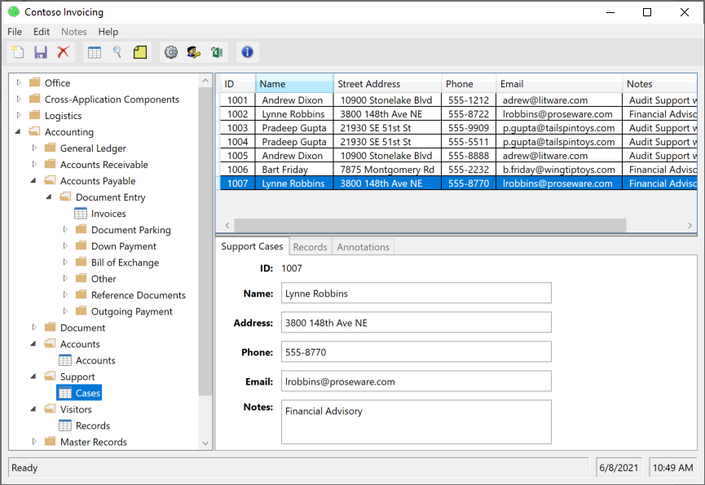
Stage 5: Robotic Process Automation (RPA)
Power Automate Desktop Flow
Cloud based workflows
Data Gateway
Desktop-based Application

Slide 20
Robotic Process Automation (RPA)
RPA Basics
Build Desktop Flow
Setup On-Premises Gateway
Integrate with Cloud-based Flow

Slide 21
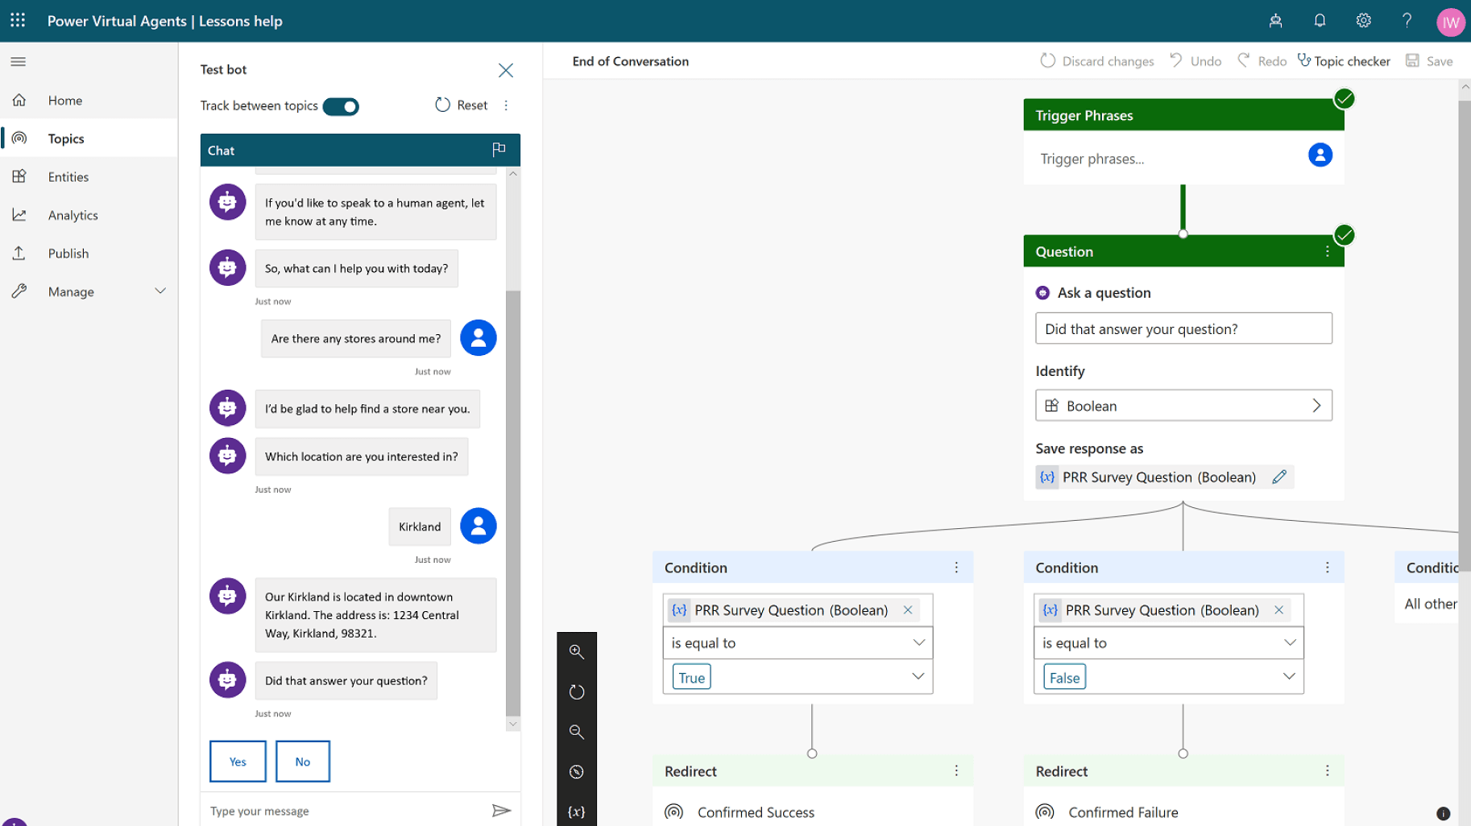

Slide 22
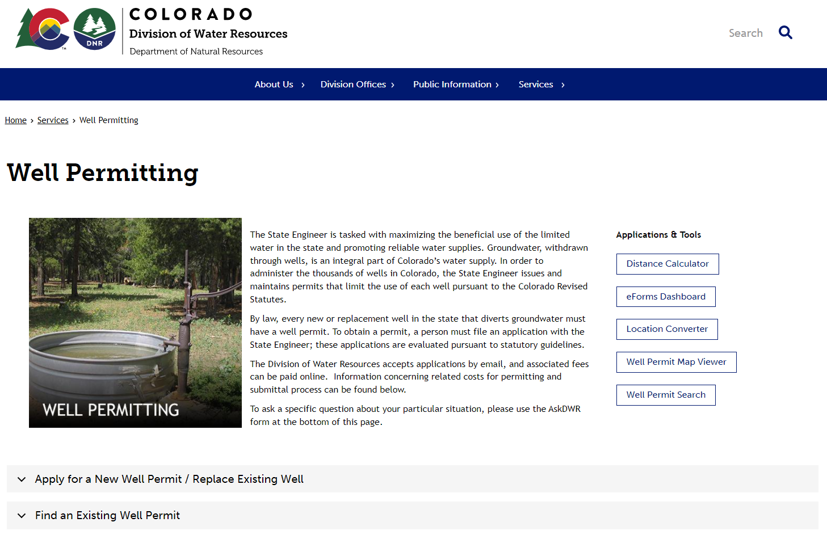

Slide 23
Power Virtual Agents (PVA)
Create data layer (table, option set)
Model-driven app
Create and Design Chatbot
Power Automate workflow integration

Slide 24
Well Permit Table
Column Name | Column Type
ID | Autonumber
Well Address | Text (address)
Home Basin | Option Set
Gallons Per Month | Whole number
Depth (ft) | Whole Number
Applicant First Name | Text
Applicant Last Name | Text
Applicant Email | Text (Email)
Denver Basin
Or
Designated Basin

Slide 25
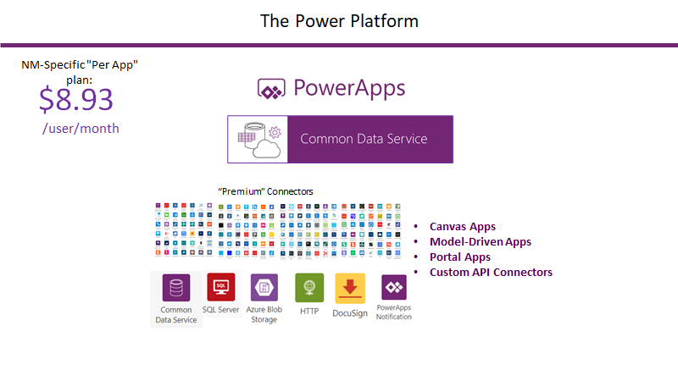

Slide 26


Tim Hanewich, Technical Specialist
timh@microsoft.com
Dustin Knudson, Solution Specialist
duknudso@microsoft.com
Notes:
Onboarding Employee (user)
Paperwork = Mark it & Attach files.
Signature from employee to confirm employment

